Slide 1
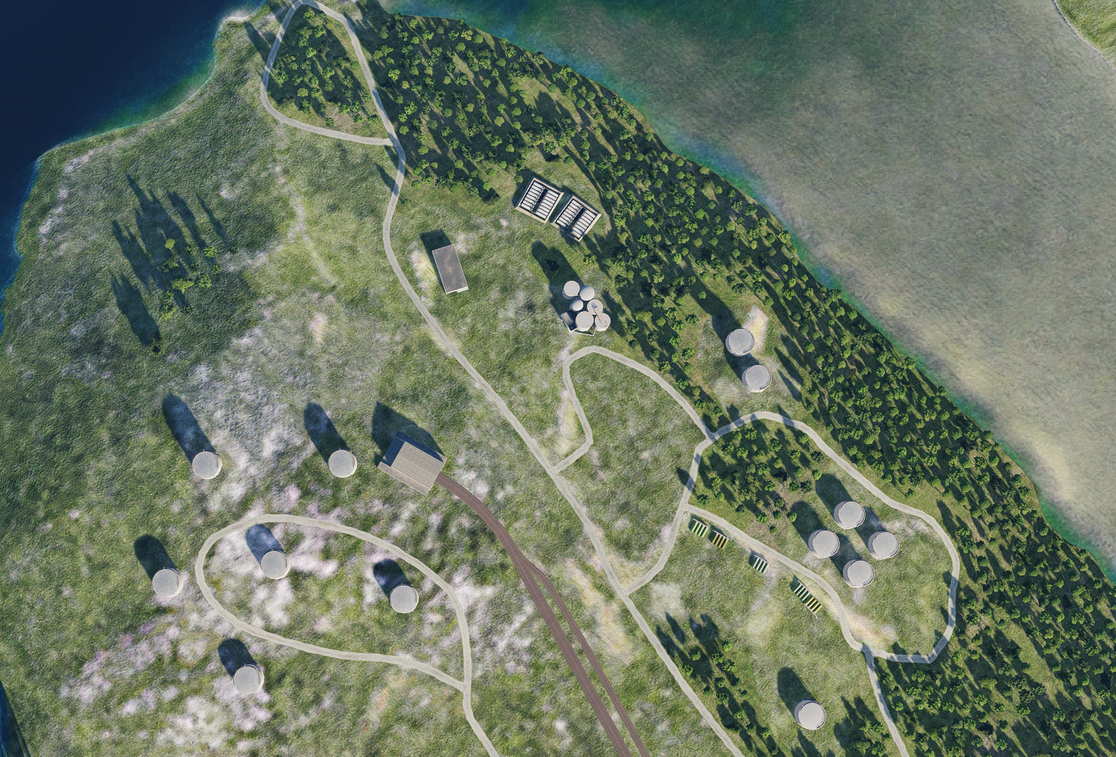
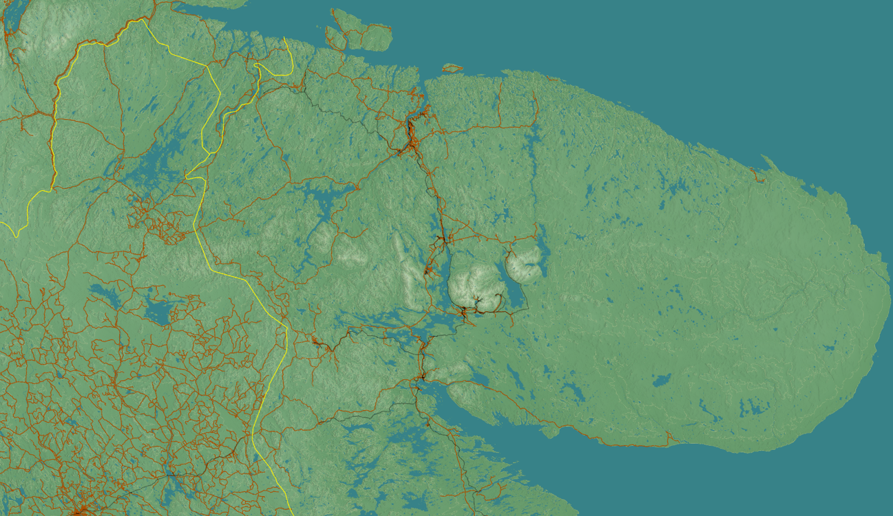
SRNTGT096 Severomorsk Fuel and Chemicals Depot
N
96
1
2
10
DESCRIPTION OF THE DESIRED POINTS OF IMPACT WITH WPN TYPE:
SRNTGT096-A – SCUD Rocket propellant
DPI 1 N 69°04.717' E 33°21.253’/121ft/(1000 Ibs bomb)
DPI 2 N 69°04.698' E 33°21.263’/124ft/(1000 lbs bomb)
SRNTGT096-B – Chemical precursor for WMD production
DPI 3 N 69°04.567' E 33°21.024’/148ft/(1000 Ibs bomb)
DPI 4 N 69°04.556' E 33°21.027’/144ft/(1000 Ibs bomb)
DPI 5 N 69°04.535' E 33°21.033’/138ft/(1000 Ibs bomb)
DPI 6 N 69°04.513' E 33°21.039’/133ft/(1000 Ibs bomb)
DPI 7 N 69°04.506' E 33°21.032’/131ft/(1000 Ibs bomb)
3
4
5
6
4
7
5
Collateral Damage Concerns in immediate area.

Slide 2
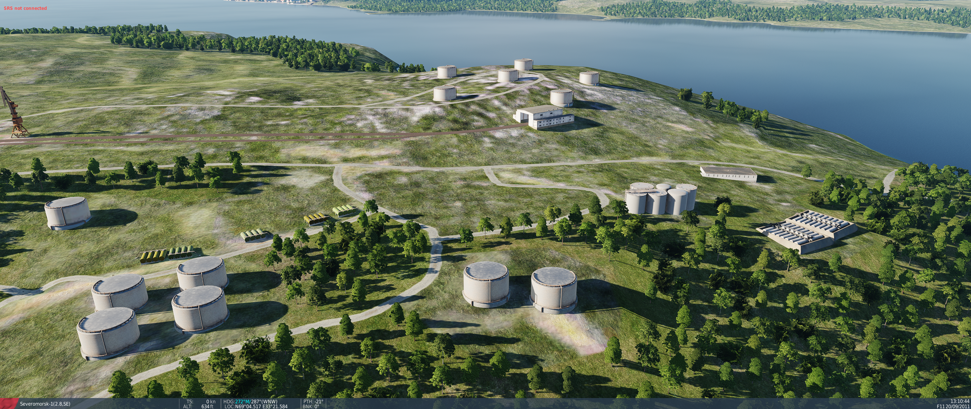
SRNTGT096 Severomorsk Fuel and Chemicals Depot
N
N
SRNTGT096-B
SRNTGT096-A
4
3
1
5
1
7
6
2
SRNTGT096-A – 16 tank Liquid Storage Tank – Reinforced Steel High Pressure Tanks in Concrete protection frame.
SRNTGT096-B – 4 tank Liquid Storage Tank – Reinforced Steel High Pressure Tanks.

